Slide 1
Automated design of hollowframe DNA origami nanostructures
A.J. Vetturini avetturi@andrew.cmu.edu
Professor Jonathan Cagan cagan@cmu.edu
Professor Rebecca E. Taylor bex@andrew.cmu.edu

Slide 2
Nanostructure design automation broadens DNA origami accessibility
Introduction
Methodology
Results
Conclusions
Q&A
Example CAD software
Typical Workflow
Design barrier(s)
Limited
caDNAno¹, scadnano²
Scaffold
Staple
Optimize
Level of Automation
Semi
MagicDNA³, ENSnano⁴, inSequio⁵
Fully
vHelix⁶, DNAForge⁷, ATHENA suite⁸
1. Douglas, S. M. et al. Nucleic Acids Research 37, no. 15 (2009): 5001–6.
2. Doty, D. et al. DNA 26, vol. 174 (2020).
3. Huang, C-M. et al. Nature Materials 20, no. 9 (2021): 9.
4. Levy, N. and Schabanel, N. DNA 27 (2021).
5. LaRock, C. et al. Preprint, bioRxiv (2024).
6. Benson, E. et al Nature 523, no. 7561 (2015): 7561
7. Elonen, A. et al. Nucleic Acids Research 52, no. W1 (2024): W13–18.
8. Jun, H. et al. Nucleic Acids Research 49, no. 18 (2021): 10265–74.
Notes:
Broadens == ease of accesibility

Slide 3
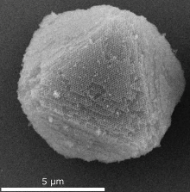
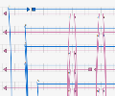
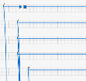
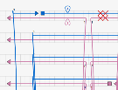
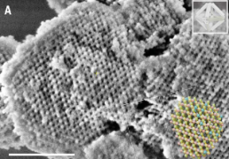
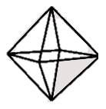
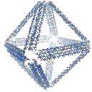
Specifically, materials research can benefit from automation
Introduction
Methodology
Results
Conclusions
Q&A
Iterate
Staple
Scaffold
Optimize
Let’s design a material for …
Design repeating unit
Posnjak, G. et al. Science 384, no. 6697 (2024): 781–85.
Optimize
assembly
Goal
Periodic structure using DNA origami
Step 1
Manual
Step 2
Fully
Automated
Mesh
TALOS¹
Liu, H. et al. Science 384, no. 6697 (2024): 776–81.
1. Jun, H. et al. ACS Nano 13, no. 2 (2019): 2083–93.
oxView: Poppleton, E. et al. Nucleic Acids Research 48, no. 12 (2020): e72.
caDNAno: Douglas, S. M. et al. Nucleic Acids Research 37, no. 15 (2009): 5001–6.
Notes:
Mention stiff enough particle

Slide 4
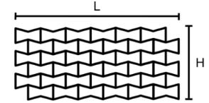
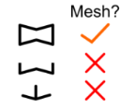
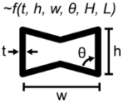
However, not all geometries can be represented in current fully automated tools
Introduction
Methodology
Results
Conclusions
Q&A
Iterate
Staple
Scaffold
Optimize
Goal
Periodic structure using DNA origami
Let’s design a material for …
Design repeating unit
Optimize
assembly
Step 1
Manual
Step 2
Response
Fully
Automated
Mesh
TALOS¹
1. Jun, H. et al. ACS Nano 13, no. 2 (2019): 2083–93.
oxView: Poppleton, E. et al. Nucleic Acids Research 48, no. 12 (2020): e72.
caDNAno: Douglas, S. M. et al. Nucleic Acids Research 37, no. 15 (2009): 5001–6.
Notes:
Mention stiff enough particle

Slide 5
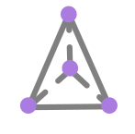
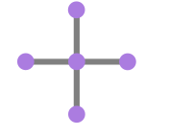
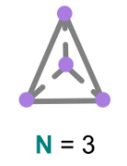
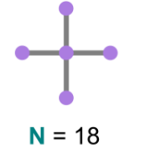
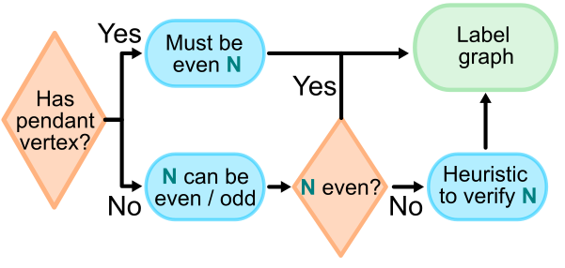
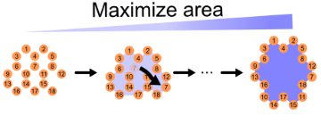
HollowfrAme DNA Origami further expands this fully-automatable design space
Introduction
Methodology
Results
Conclusions
Q&A
Input
Scaffold Routing
1) Initialize graph
2
18
3
1) Vertex-and-edge model
2) Specify N (i.e., thickness)
N = 18
Notes:
HADO gives access to thickness control and fully automated designs
HADO == Ryu

Slide 6
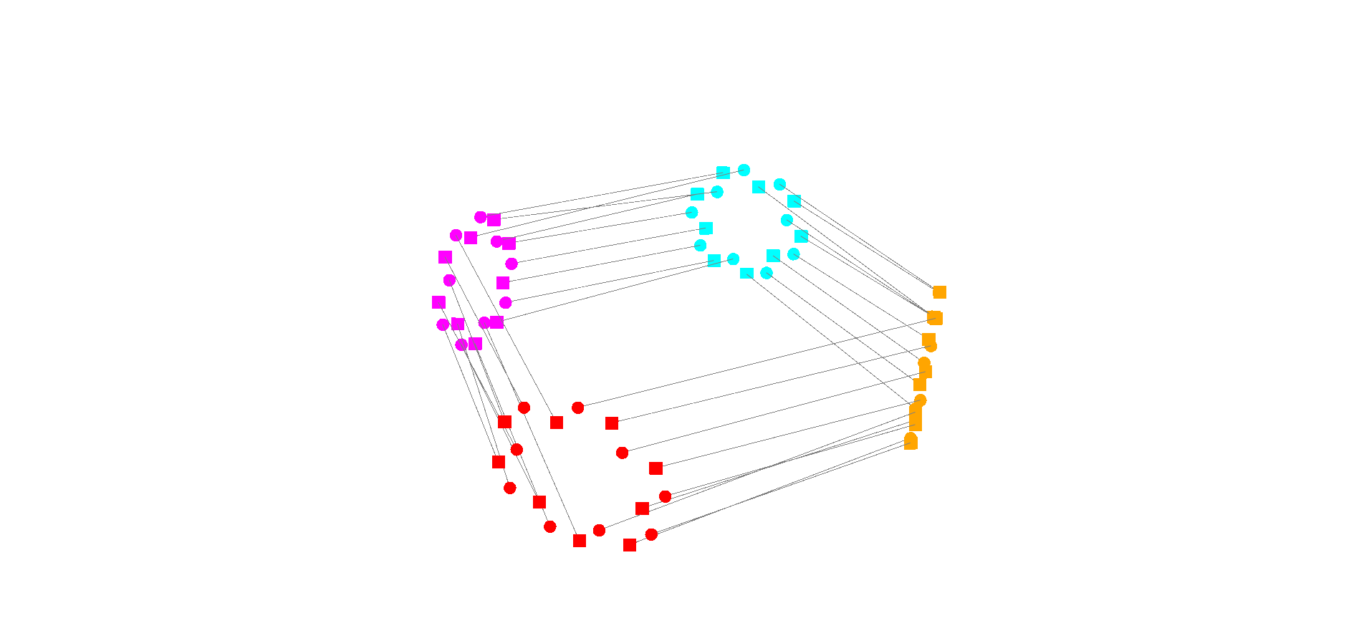
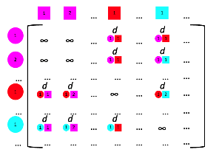

HollowfrAme DNA Origami further expands this fully-automatable design space
Introduction
Methodology
Results
Conclusions
Q&A
Input
Scaffold Routing
1) Initialize graph
2
18
3
1) Vertex-and-edge model
2) Specify N (i.e., thickness)
2) Connect bundles
5’ Ends
N = 18
Goal
Rotate bundles minimizing total distance
3’ Ends
2
2
1
Notes:
Each vertex form a linear assignment problem leveraging the directionality of DNA (The assignment problem consists of finding, in a weighted bipartite graph, a matching of maximum size, in which the sum of weights of the edges is minimum.)
The internal cycles are then connected using MST via a

Slide 7
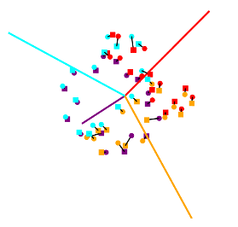
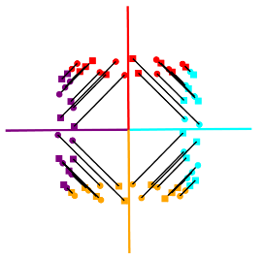
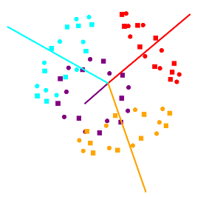
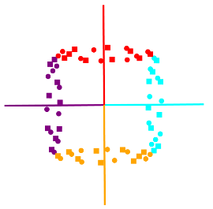
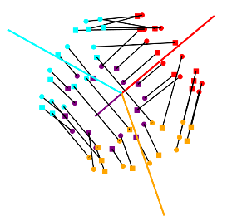
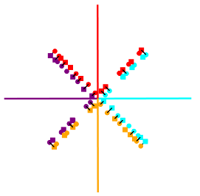
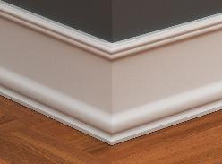
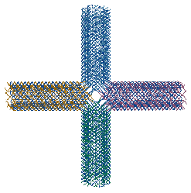
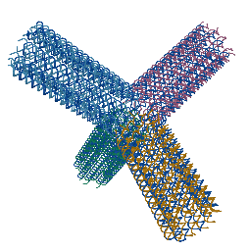
Mitering imparts global stiffness into the structure
Introduction
Methodology
Results
Conclusions
Q&A
AA
AA
Top View
1
2
1
2
Image from https://www.nationalassemblers.com/post/floor-trim-selection
Miter corners for flush fit
For each connection, move towards shared vertex by 0.34 nm until thresold met
35 nm
35 nm
Without mitering, these designs would have similar outputs
N = 18
N = 18
Notes:
Emphasize / calrify scaffold routing (and not be knotted)

Slide 8
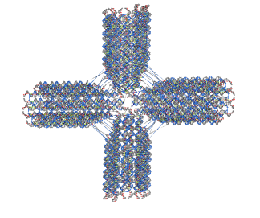
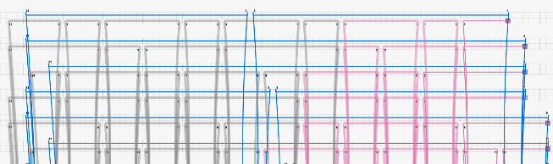
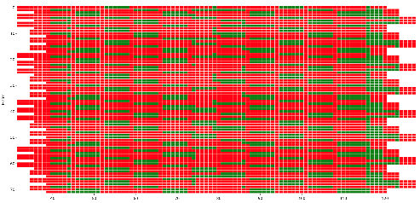




Dynamic programming defines the staple set
Introduction
Methodology
Results
Conclusions
Q&A
1. Add staples and default crossovers
2. Select optimal break points to segment staples
Bundle
Ends
Bundle
Middle
min $\sum{{\left(L_{i}−L_{target}\right)}^{2}}$
s.t.
a
b
Example grid of valid break points
Defaults set by 45K design analysis
$$20 ≤L_{i}≤60$$
c
a > 5
b > 3
c > 3
oxView: Poppleton, E. et al. Nucleic Acids Research 48, no. 12 (2020): e72.
caDNAno: Douglas, S. M. et al. Nucleic Acids Research 37, no. 15 (2009): 5001–6.
(all in units of # nucleotides)

Slide 9
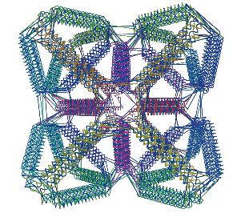
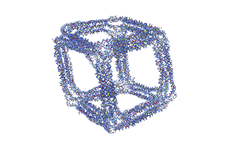
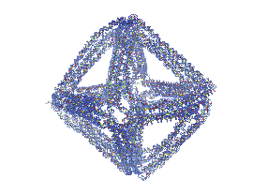
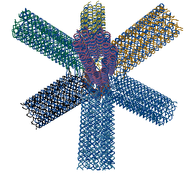
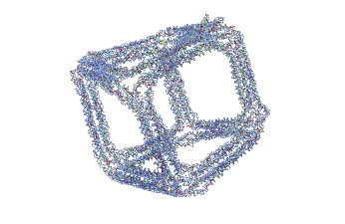
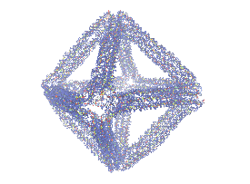
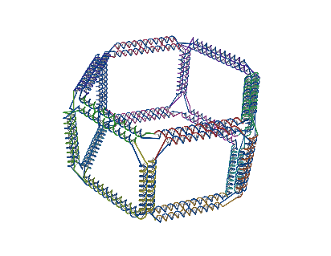
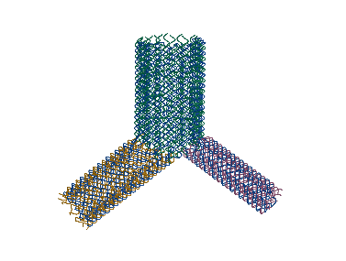
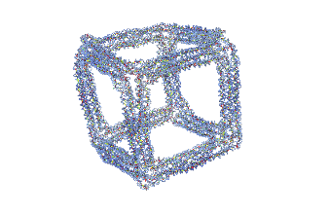
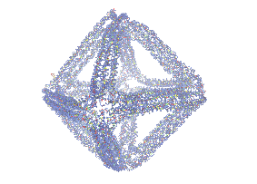
HADO platform can be used across hollowframe / wireframe geometries
Introduction
Methodology
Results
Conclusions
Q&A
Example Designs
6HB Wireframe Comparison
HADO
TALOS-I
RMSF (nm)
1.0
4.0
TALOS-M
oxView: Poppleton, E. et al. Nucleic Acids Research 48, no. 12 (2020): e72.
Notes:
Octet truss, BCC Truss, Hexa Prism, Anisotropic Y Junction

Slide 10
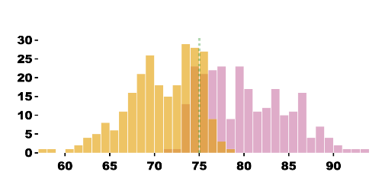
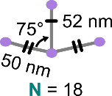
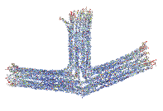

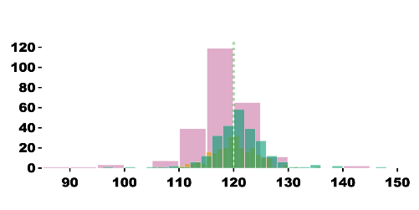
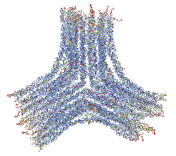
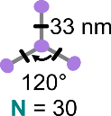
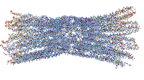
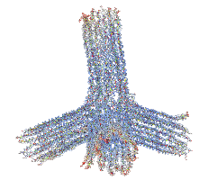
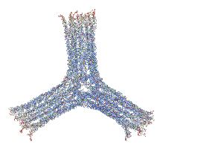
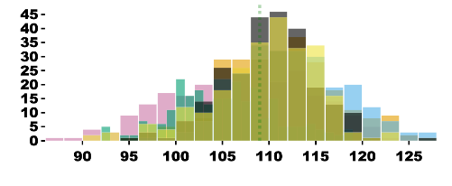

Three sample designs illustrate the HADO paradigm
Introduction
Methodology
Results
Conclusions
Q&A
Input
RMSF (nm)
oxDNA Analysis
0.5
4.5
Target: 75
Arrow
N=18
Count
Target: 120
Count
Y Junction
N=30
Target: 109
Count
Tetrapod
N=18
Angle Between Bundle (deg)
oxView: Poppleton, E. et al. Nucleic Acids Research 48, no. 12 (2020): e72.
Notes:
30 HB: ~15 nm cavity
18 HB: ~10 nm cavity

Slide 11









Three sample designs illustrate the HADO paradigm
Introduction
Methodology
Results
Conclusions
Q&A
Arrow
Y Junction
Tetrapod
N=18
N=30
N=18
nm
0.0
5.0
AFM scale consistent across all images | All scale bars 50 nm

Slide 12





NUPACK used to define optimized sticky ends optimized for assembly
Introduction
Methodology
Results
Conclusions
Q&A
Generate valid combinations & screen melting temperature
Build NUPACK interaction matrix¹
Filter: $T_{m}±δT$
GPU-based simulated annealing to find optimal set of N seqs
M simulated
annealings in parallel
1. Diep, T. et al. ChemRxiv 2025, no. 1224 (n.d.).
Notes:
250 choose 8 sequences is on order of 10^14
The matrix: NUPACK partion function for all pairs to get ensemble free energy (esf) value (kcal/mol) via NUPACK. A more negative (i.e., more blue) ensemble free energy means that the bound ensemble of strand a / b is favorable. A less negative (i.e., more yellow) means that they are less favorable. The diagonal in quadrant B is the strand + its reverse complement which is why that is most negative
Cross talk: Looking for largest energy difference between on target of sequence and the complements
Stacking: Looking for largest energy difference between sequences and themselves (ignoring complements)
Margin is adding the average binding energy of the set to the largest margin
ESF accounts for the contributions of all possible secondary structures and base-pairing probabilities,
Vecorization (JAX): Single Instruction, Multi-Data
Parallelization: Task-level concurrency (e.g., Multi-Instruction, Multi-Data)

Slide 13




Overall, this work introduces a web-based, fully-automated platform for DNA origami
Introduction
Methodology
Results
Conclusions
Q&A
Future: Embed symmetry + thickness into generative design¹
Automation driven via sequential optimization steps
Ability to parameterize bundle thickness
Design mesh inside inside streamlit GUI or import / use Python API
Response
$$\frac{V_{box}}{V_{DNA}}$$
1. Vetturini, A. J., Cagan, J. and Taylor, R. E. Nucleic Acids Research 53, no. 2 (2025): gkae1268.

Slide 14



Introduction
Methodology
Results
Conclusions
Q&A
Support
Acknowledgements
Prof. James Conway (Pitt)
Anuhya Edupuganti (CMU)
Isabella Ferranti (CMU)
Vismaya Walawalker (CMU)
Questions?
Note: QR code likely inactive
Connect with me!
Read more about our groups
andrew.cmu.edu/user/bex/pages/welcome/
cmu.edu/me/idig/
ajvetturini.github.io
Vetturini, A. J., Cagan, J. and Taylor, R. E. In Preparation (2026).
Notes:
National Defense Science and Engineering Graduate Fellowship

Slide 15
Backup Slides

Slide 16








DNA origami has been increasingly used in materials research
Introduction
Methodology
Results
Conclusions
Q&A
Lattice-based
Wireframe
Diamond¹
Pyrochlore³
Plasmonic²
Mechanical Metamaterial⁴
1. Posnjak, G. et al. Science 384, no. 6697 (2024): 781–85.
2. Wang, P. et al. JACS 138, no. 24 (2016): 7733–40.
3. Liu, H. et al. Science 384, no. 6697 (2024): 776–81.
4. Kulikowski, J. et al. Matter 7, no. 6 (2024): 2144–60.

Slide 17






The same annealing protocol was used for both 18HB and 30HB designs
Introduction
Methodology
Results
Conclusions
Q&A
M13
(20 nM)
Annealing Protocol
20 nM origami M13
200 nM staple mix
22 hr anneal
1X TAE @ 8.3 pH
N MgCl₂
2
4
6
8
10
2
4
6
8
10
2
4
6
8
10
mM MgCl₂
10
12
14
16
20
10
12
14
16
20
10
12
14
16
20
mM MgCl₂
20
22
24
26
30
20
22
24
26
30
20
22
24
26
30
mM MgCl₂
2% Agarose Gel run in 1X TAE for 75 min @ 100 V

Slide 18






Measuring angles of oxDNA trajectory
=
Trajectory
Define which nucleotides belong to which bundle
Define which bundles should be measured
Fit a spline and measure the average angle between points for oxDNA trajectory

Slide 19



Fitting staple default args using ~45k caDNAno designs
a
c
b
Target
min $\sum{{\left(L_{i}−L_{target}\right)}^{2}}$
s.t.
$$20 ≤L_{i}≤60$$
a > 5
b > 3
c > 3
Bundle
Ends
Bundle
Middle
a
b
c

Slide 20

Fitting staple default args using ~45k caDNAno designs
a
c
b
Target
min $\sum{{\left(L_{i}−L_{target}\right)}^{2}}$
s.t.
$$20 ≤L_{i}≤60$$
a > 5
b > 3
c > 5
Bundle
Ends
Bundle
Middle
a
b
c

Slide 21

Fitting staple default args using ~45k caDNAno designs
a
c
b
Target
min $\sum{{\left(L_{i}−L_{target}\right)}^{2}}$
s.t.
$$20 ≤L_{i}≤60$$
a > 5
b > 5
c > 3
Bundle
Ends
Bundle
Middle
a
b
c

Slide 22

Fitting staple default args using ~45k caDNAno designs
Target
c

Slide 23

Other assembly pictures

