Slide 1
A Grammar-Enabled Generative Design Framework for Design Exploration of Deoxyribonucleic Acid (DNA) Nanostructures
A.J. Vetturini avetturi@andrew.cmu.edu
Professor Jonathan Cagan cagan@cmu.edu
Professor Rebecca E. Taylor bex@andrew.cmu.edu
Notes:
Main title: 40 pt. Arial
Presenter Name: 16 pt. Arial
Presenters Title: 16 pt. Arial Italic

Slide 2
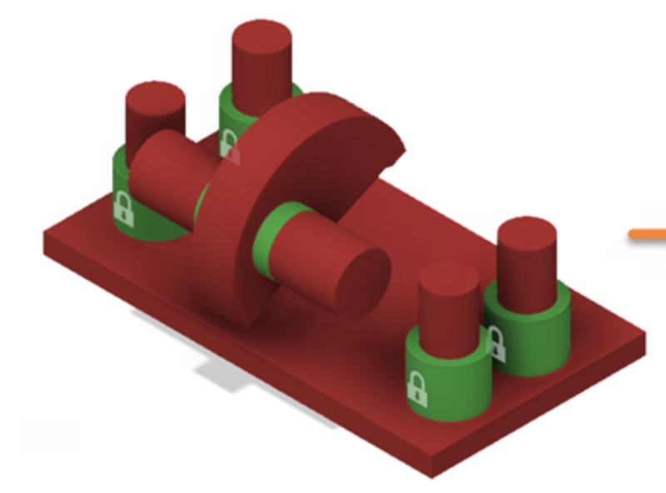
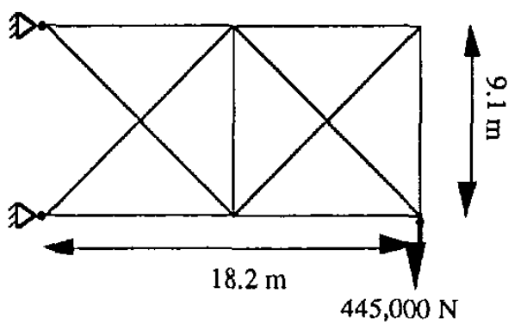
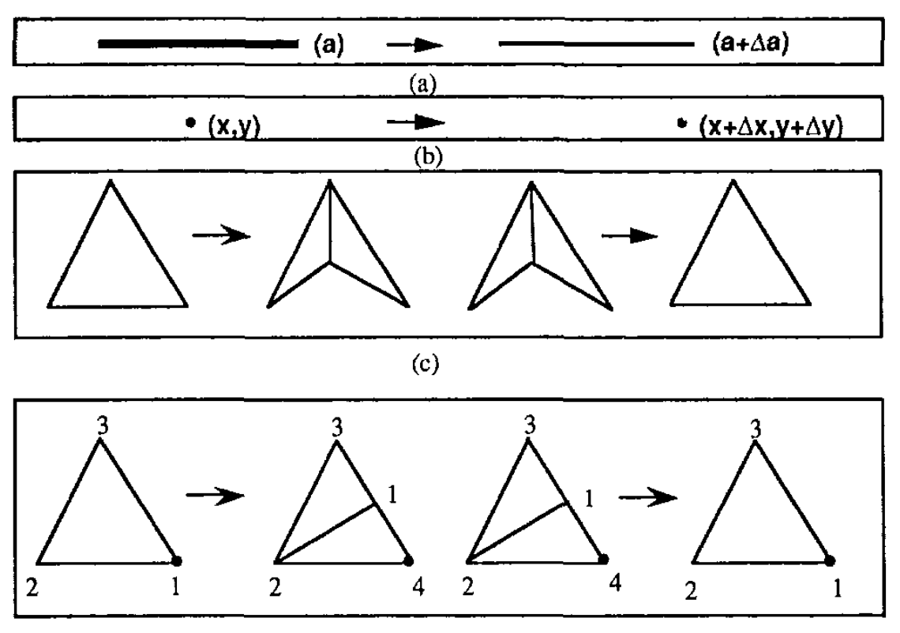
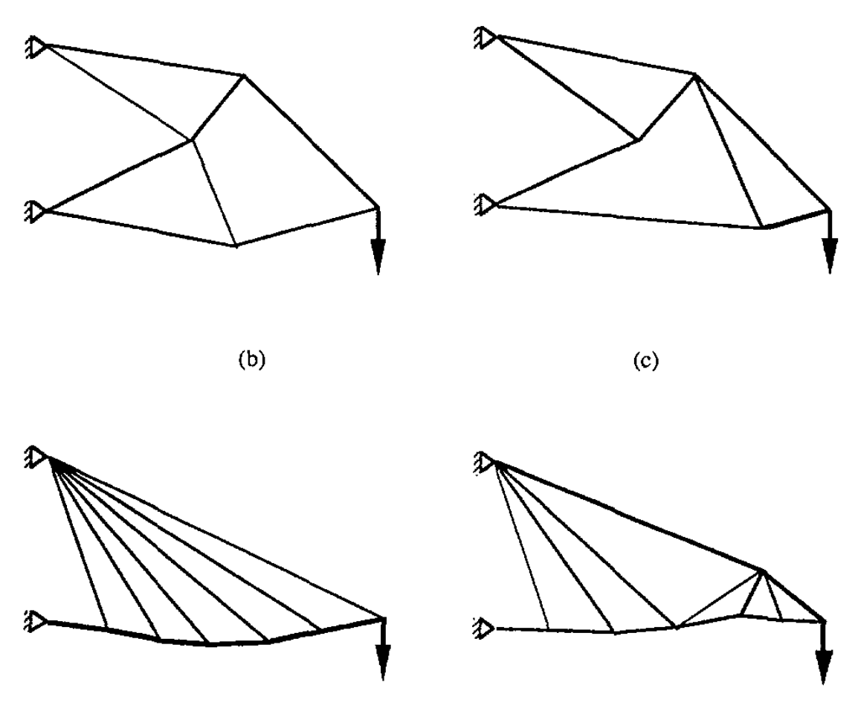
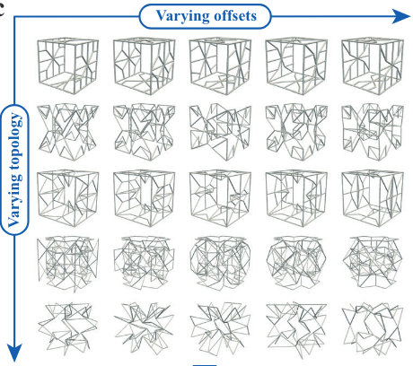
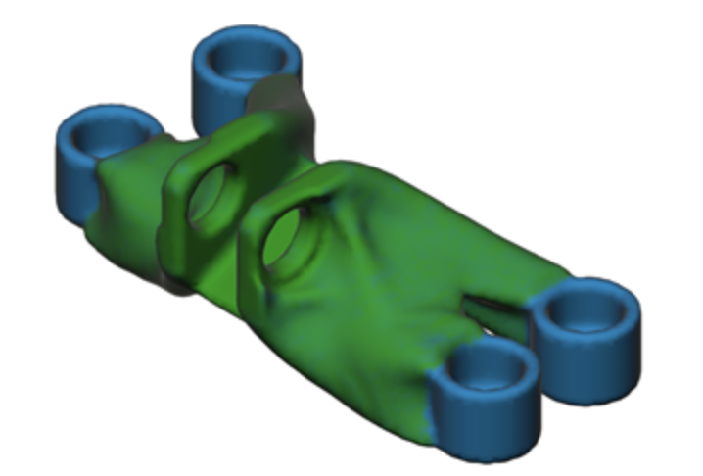
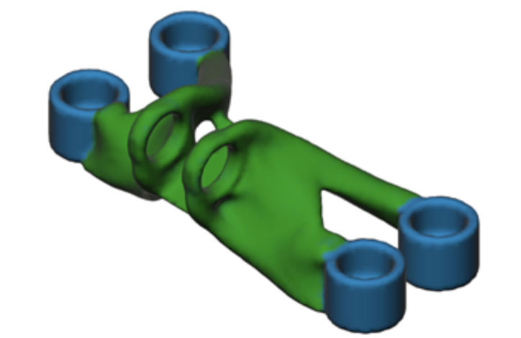
Generative design has seen broad application in a variety of domains
Introduction
Methodology
Results
Conclusions
Q&A
Generative design solutions that can produce many unique design solutions based on designer requirements
Truss design through stochastic optimization¹ and data-driven learning²
Target a specific part weight
Minimize total weight
1. Reddy and Cagan. Journal of Mechanical Design 117, no. 2A (1995): 315–21.
2. Zheng et al. Nature Communications 14, no. 1 (2023): 7563.
Images from https://help.autodesk.com/view/fusion360/ENU/?guid=GD-TUT-GE-BRACKET-QS
Notes:
Generative design methodologies have rapidly advanced throughout literature and has been applied to fields such as topology design, architecture, trusses, etc. using a variety of methods (deterministic, analytical solutions to drive optimization compared to deep learning models).
Most interestingly, these solutions can also vary based on the input: ranging from an initial “guess” solution to deriving a full design solution from a minimal set of input conditions
Benefits of Deterministic: A truly optimal solution guided by pure mechanics / mathematics
Benefits of stochastic: Exploration, produce novel solutions to inspire ideation
Study on the left targeted a specific weight, the one on the right just minimized the total weight of the part.

Slide 3
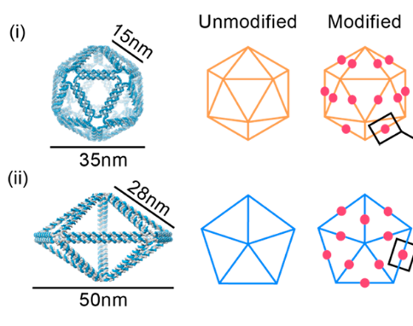
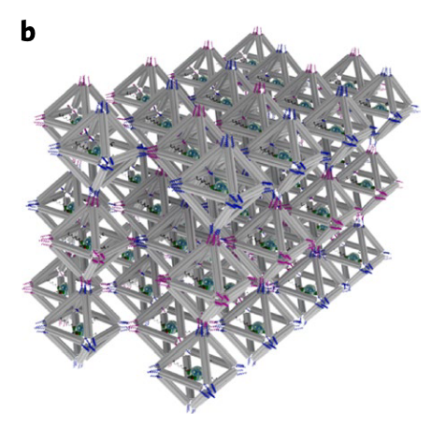
DNA origami nanostructures are an interesting design space with broad applications
Introduction
Methodology
Results
Conclusions
Q&A
Example 1
Example 2
DNA origami
Nanoparticle
Programmable design features to modulate immune pathway activation for therapeutics¹
Nanoscale synthesis of targeted material fabrication²
1. Du et al. ACS Nano 16, no. 12 (2022): 20340–52.
2. Tian et al. Nature Materials 19, no. 7 (2020): 789–96.
A deeper review of DNA origami applications can be found at: Dey et al. “DNA Origami.” Nature Reviews Methods Primers 1, no. 1 (2021): 1–24.
Notes:
One particularly mortivating design space is that of DNA origami nanostrures which …
DNA origami nanostructures are on the scale of ~10s to 100s of nanometers and can be used in a variety of applications.

Slide 4
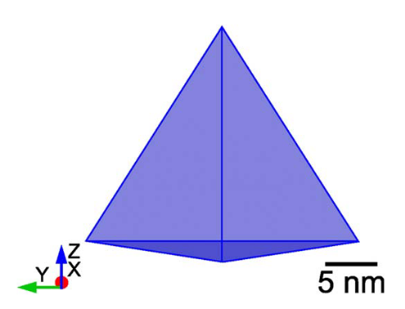
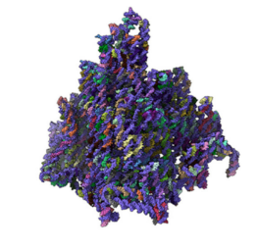
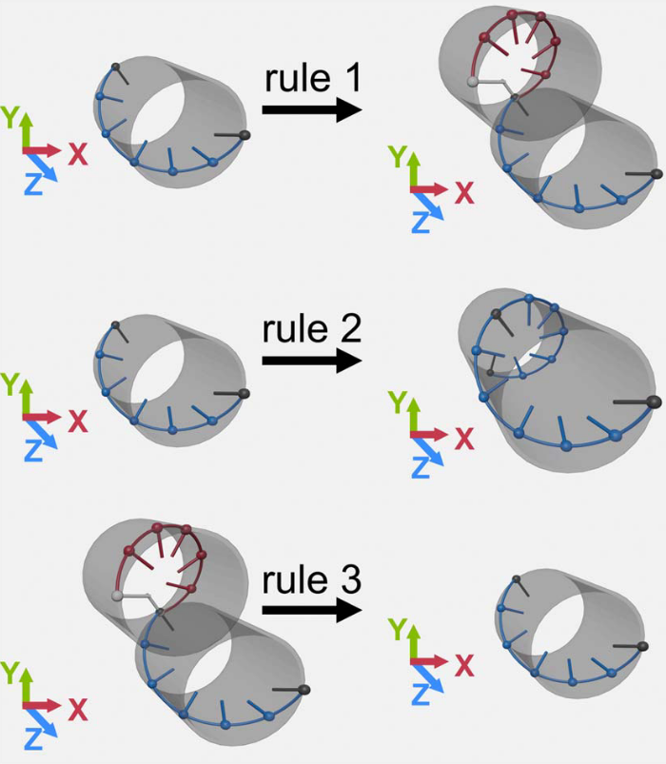
Generative approaches have considered the scaffold routing design of DNA origami
Introduction
Methodology
Results
Conclusions
Q&A
Designer Input
Generated solution
Input consists of:
Mesh
Optimizer hyperparameters
Objective function selection
Two limitations:
The solution resembles the input mesh
Designer has limited control over the search
1. Babatunde et al. Applied Sciences 11, no. 7 (021): 2950.
2. Babatunde et al. Journal of Mechanical Design 146, no. 051708 (2024).
Notes:
The application is to either fill the mesh or coat the mesh which has applications in nanocasting methodologies.
“This solution requires that the designer fully consider and design their ideal mesh prior to the generative solution”. Relies on the expertise of the designer to create said mesh.

Slide 5
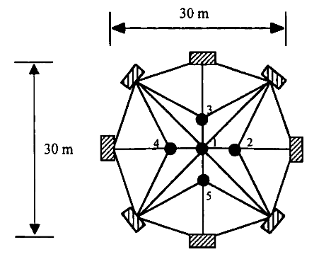
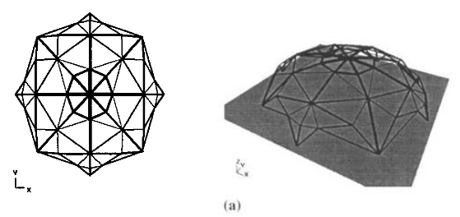
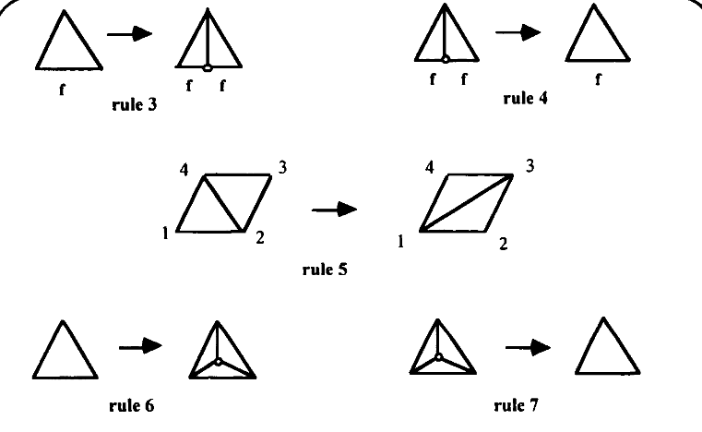
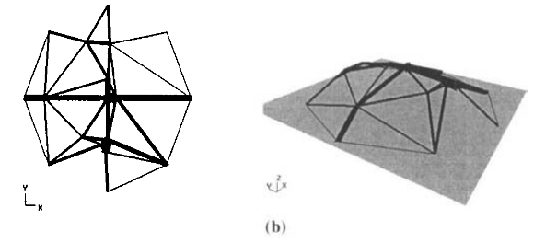
Generative design offers an approach to searching a difficult space
Introduction
Methodology
Results
Conclusions
Q&A
Challenges presented by DNA origami design:
Conceptual difficulty
Design software limitations
Lack of data
Computational cost of molecular dynamics simulations
Difficult design space to manually explore
A solution to these problems is Shape Annealing^{1,2}
Pros and Cons to Shape Annealing
Ability to encode design-specific context
Capable of searching complex spaces
Stochastic optimization enacts design exploration
Inherent bias by grammar rules
Initial state
Shape grammars
Shape annealing is the combination of shape grammars³ with simulated annealing⁴
1. Cagan and Mitchell. Environment and Planning B: Planning and Design 20, no. 1 (1993): 5–12.
2. Shea and Cagan. AI EDAM 11, no. 5 (1997): 379–94.
3. Stiny, G. Environment and Planning B: Planning and Design 7, no. 3 (1980): 343–51.
4. Kirkpatrick et al. Science 220, no. 4598 (1983): 671–80.
Notes:
To talk a little more about the DNA origami design space…
One way to explore upon a difficult design space is through shape annealing which …

Slide 6
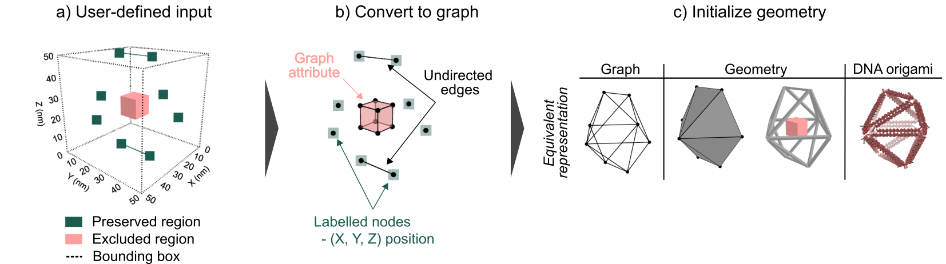
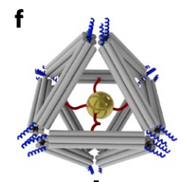
The design space used in this problem is comprised of preserved regions and excluded regions
Introduction
Methodology
Results
Conclusions
Q&A
DNA origami
1. User input
2. Convert input to graph
3. Initialize first state
DNA origami frame hosting a gold nanoparticle¹
Preserved regions Edges or vertices that remain in the final design
Excluded regions Regions where material can not be placed
1. Tian et al. Nature Materials 19, no. 7 (2020): 789–96.
Notes:
To begin formalizing the design problem, I want to introduce some design elements I use in this work.
If > 6 mins, SPEED UP

Slide 7
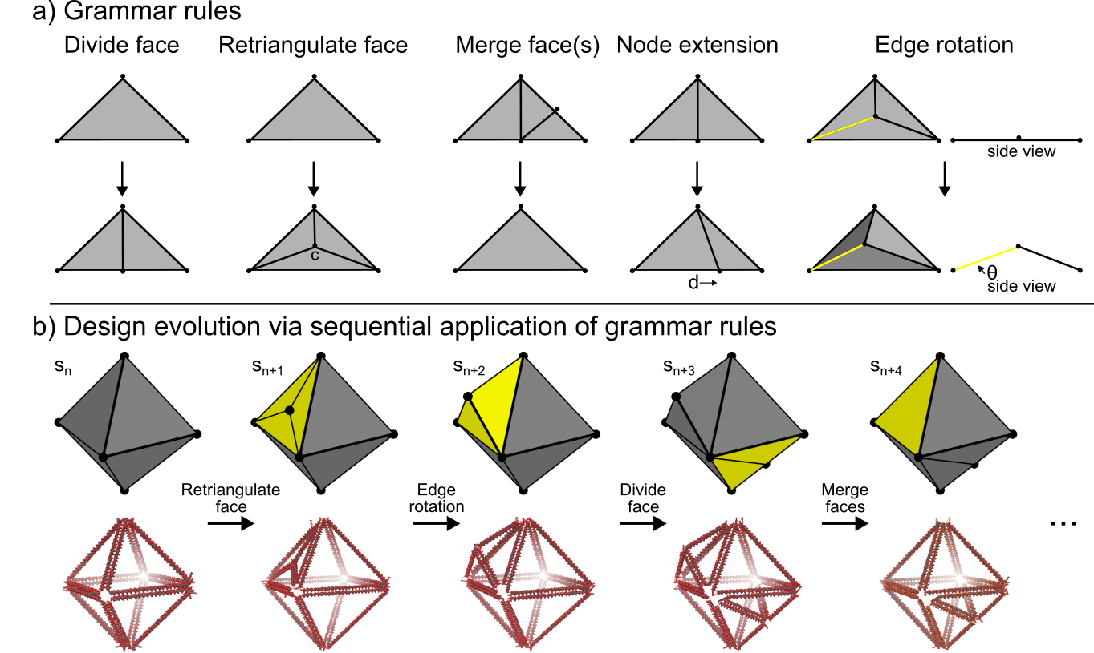
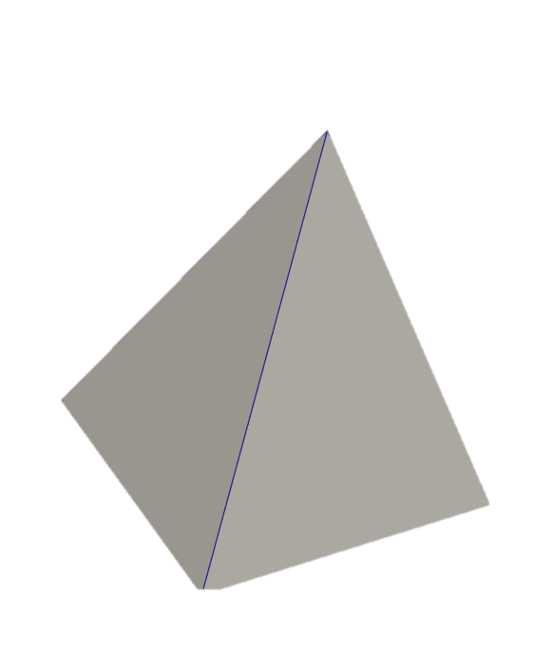
A graph grammar is used to modify a graph representing a polyhedral mesh
Introduction
Methodology
Results
Conclusions
Q&A
Grammar Rules
Graph Representation
Example 3D mesh
Example design evolution
Graph describing example mesh
Attributes
(x, y, z)
Terminal?
Edge length
Mesh visualized via ParaView (Ahrens et al. The Visualization Handbook 717 (2005): 50038–1.)
DNA designs visualized via VMD (Humphrey et al. Journal of Molecular Graphics 14 (1996): 33–38.)

Slide 8


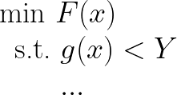
Simulated annealing¹ is used to search the resulting space
Introduction
Methodology
Results
Conclusions
Q&A
1
An annealing schedule² varies T hyperparameter that balances exploration vs exploitation
5
3
Objective
Function
2
4
5
6
x
1. Kirkpatrick et al. Science 220, no. 4598 (1983): 671–80.
2. Huang et al. In Proc. IEEE Int. Conf. on CAD (ICCAD 86), 1986.

Slide 9
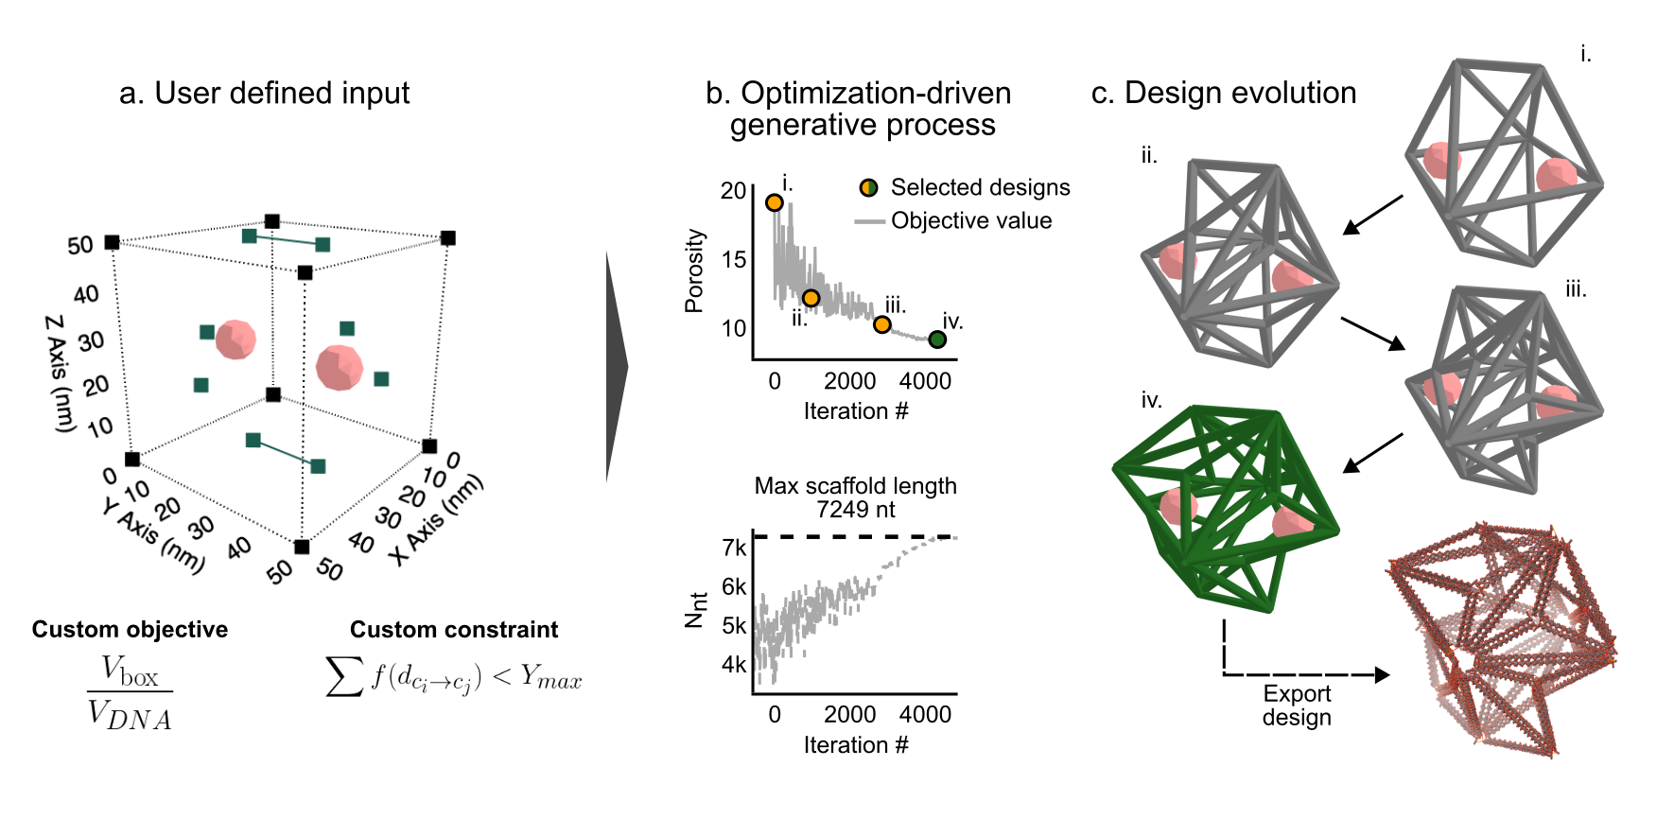


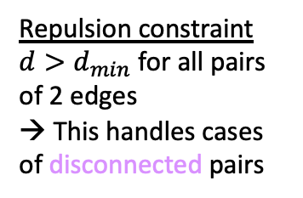

Designer can tune the constraints and objective of the problem
Introduction
Methodology
Results
Conclusions
Q&A
The objective and constraints of the problem can be defined using the (documented!) Python package¹
Designer-defined constraint
Designer-defined objective
The backbone of DNA is negatively charged
$$d$$
Repulsion constraint
$d>d_{min}$ for all pairs of 2 edges
→ This handles cases of disconnected pairs
Having more edges allows for a greater number of modifications²
$$d$$
Design objective
A design with as many edges in a volumetric box
$$\frac{V_{box}}{V_{DNA}}$$
min
1. https://github.com/CMU-Integrated-Design-Innovation-Group/Mango
2. Du et al. ACS Nano 16, no. 12 (2022): 20340–52.
Notes:
Due to the variety of applications, it is often the case that a designer would want to specify various constraints and objectives to search for DNA origami designs

Slide 10
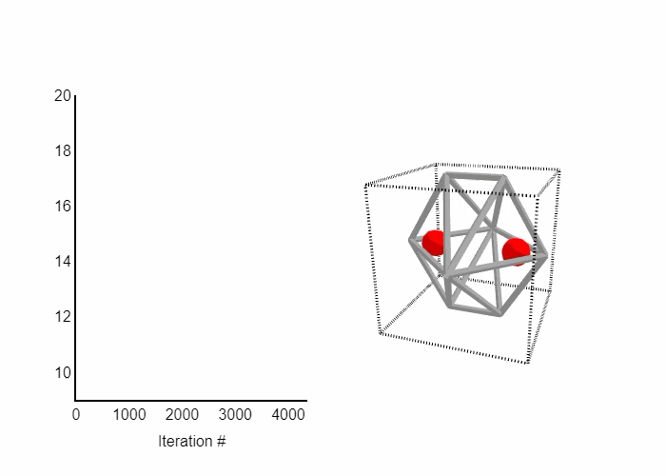

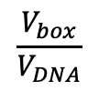

Generative design offers the ability to tune the search space
Introduction
Methodology
Results
Conclusions
Q&A
Input
$$\frac{V_{box}}{V_{DNA}}$$
Custom Objective
Additional Constraints
$$\frac{V_{box}}{V_{DNA}}$$
d
$$d>d_{min}$$
Iteration #
Export design
Notes:
An optimally directed solution

Slide 11
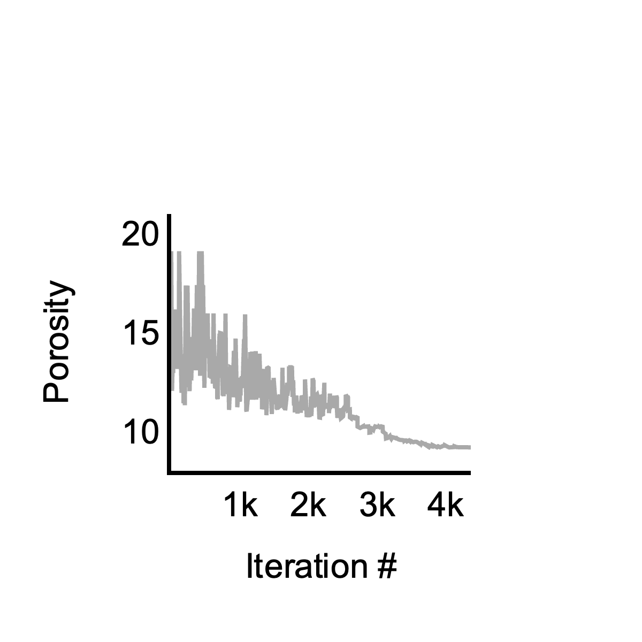
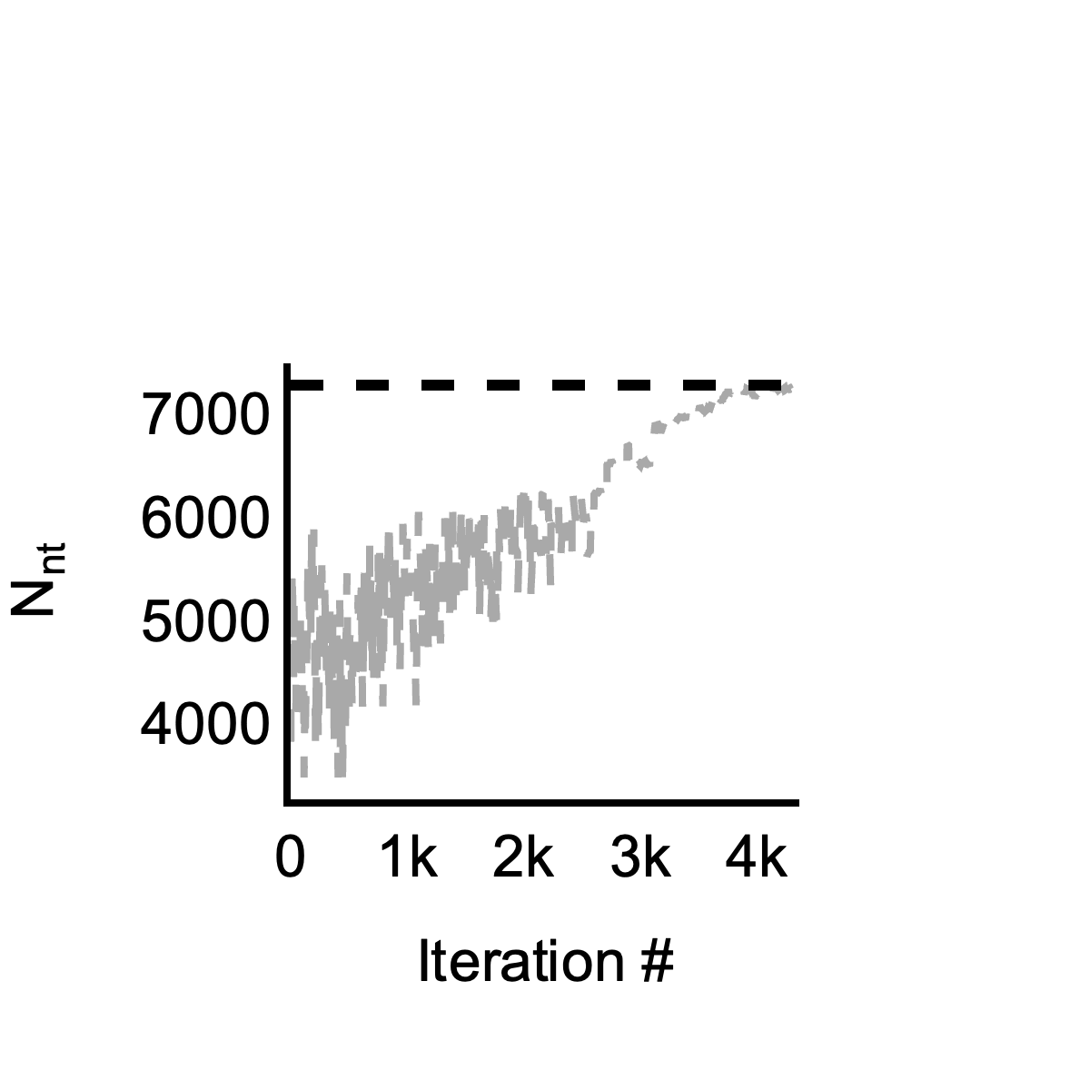
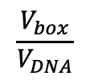

The scaffold length must be fully considered in the search
Introduction
Methodology
Results
Conclusions
Q&A
This custom objective will drive the search to use as much of the scaffold as possible
Custom Objective
$$\frac{V_{box}}{V_{DNA}}$$
$$\frac{V_{box}}{V_{DNA}}$$
The scaffold length serves as an upper-limit constraint to the generative search
DNA origami¹ consists of:
Scaffold (~7k nucleotides)
Short, synthetic staples (20-60 nucleotides)
And when combined with a thermal annealing process, DNA origami nanostructures can be formed¹!
This value can not be exceeded
Further, the design should ideally utilize as much of the scaffold as possible
1. Rothemund, P. Nature 440, no. 7082 (2006): 297–302.

Slide 12
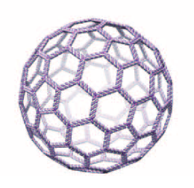
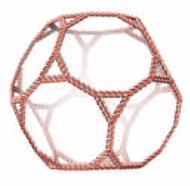
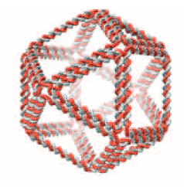
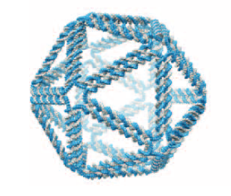
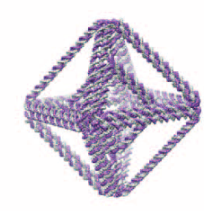
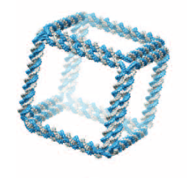
Generative design can also be used to explore upon the design space
Introduction
Methodology
Results
Conclusions
Q&A
Sometimes, generative design is used in an exploratory fashion, such as when the standard deviation is used as an aesthetic score¹
Furthermore, recent approaches have proposed novel scaffolds of different lengths²
?
Unexplored
space
Initial state
Shape grammars
Scaffold Length
Variation in Edge Length
(Std. dev of normalized edge lengths)
1. Shea and Cagan. AI EDAM 11, no. 5 (1997): 379–94.
2. Chen et al. ACS Applied Materials & Interfaces 10, no. 29 (2018): 24344–48.
Selected designs from Veneziano et al. Science 352, no. 6293 (2016): 1534–1534.
Notes:
Dataset was meticulously designs (edges are all exact multiple edge lengths0

Slide 13
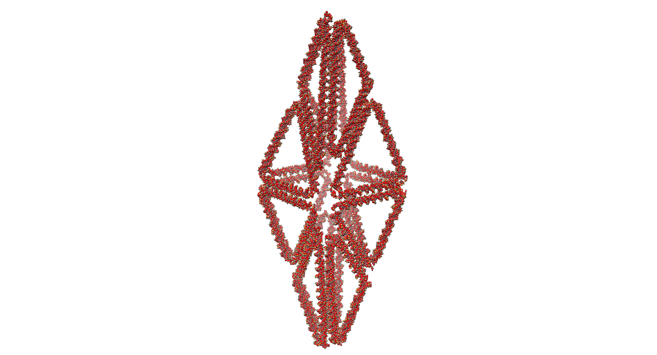
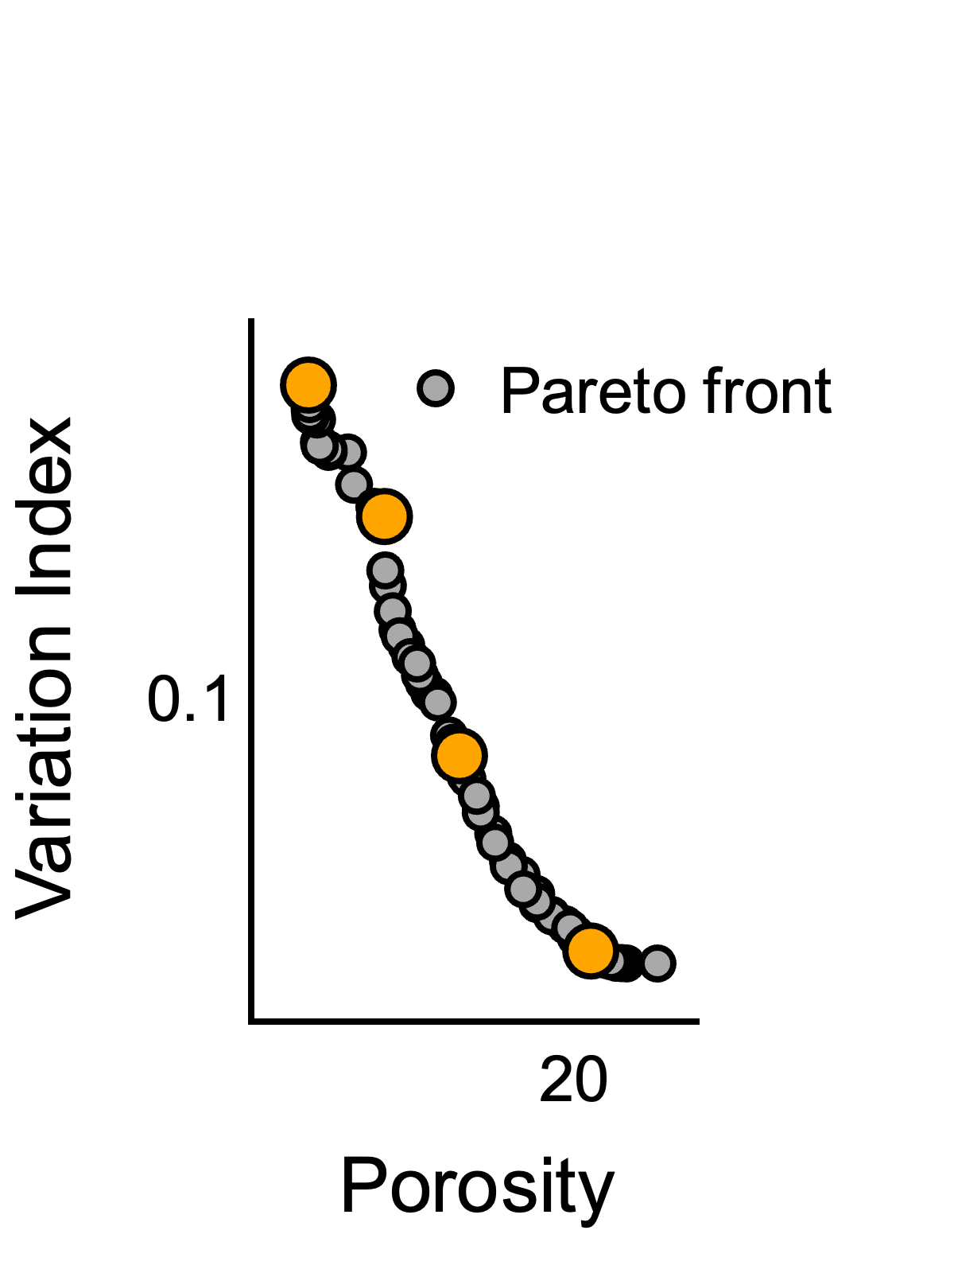
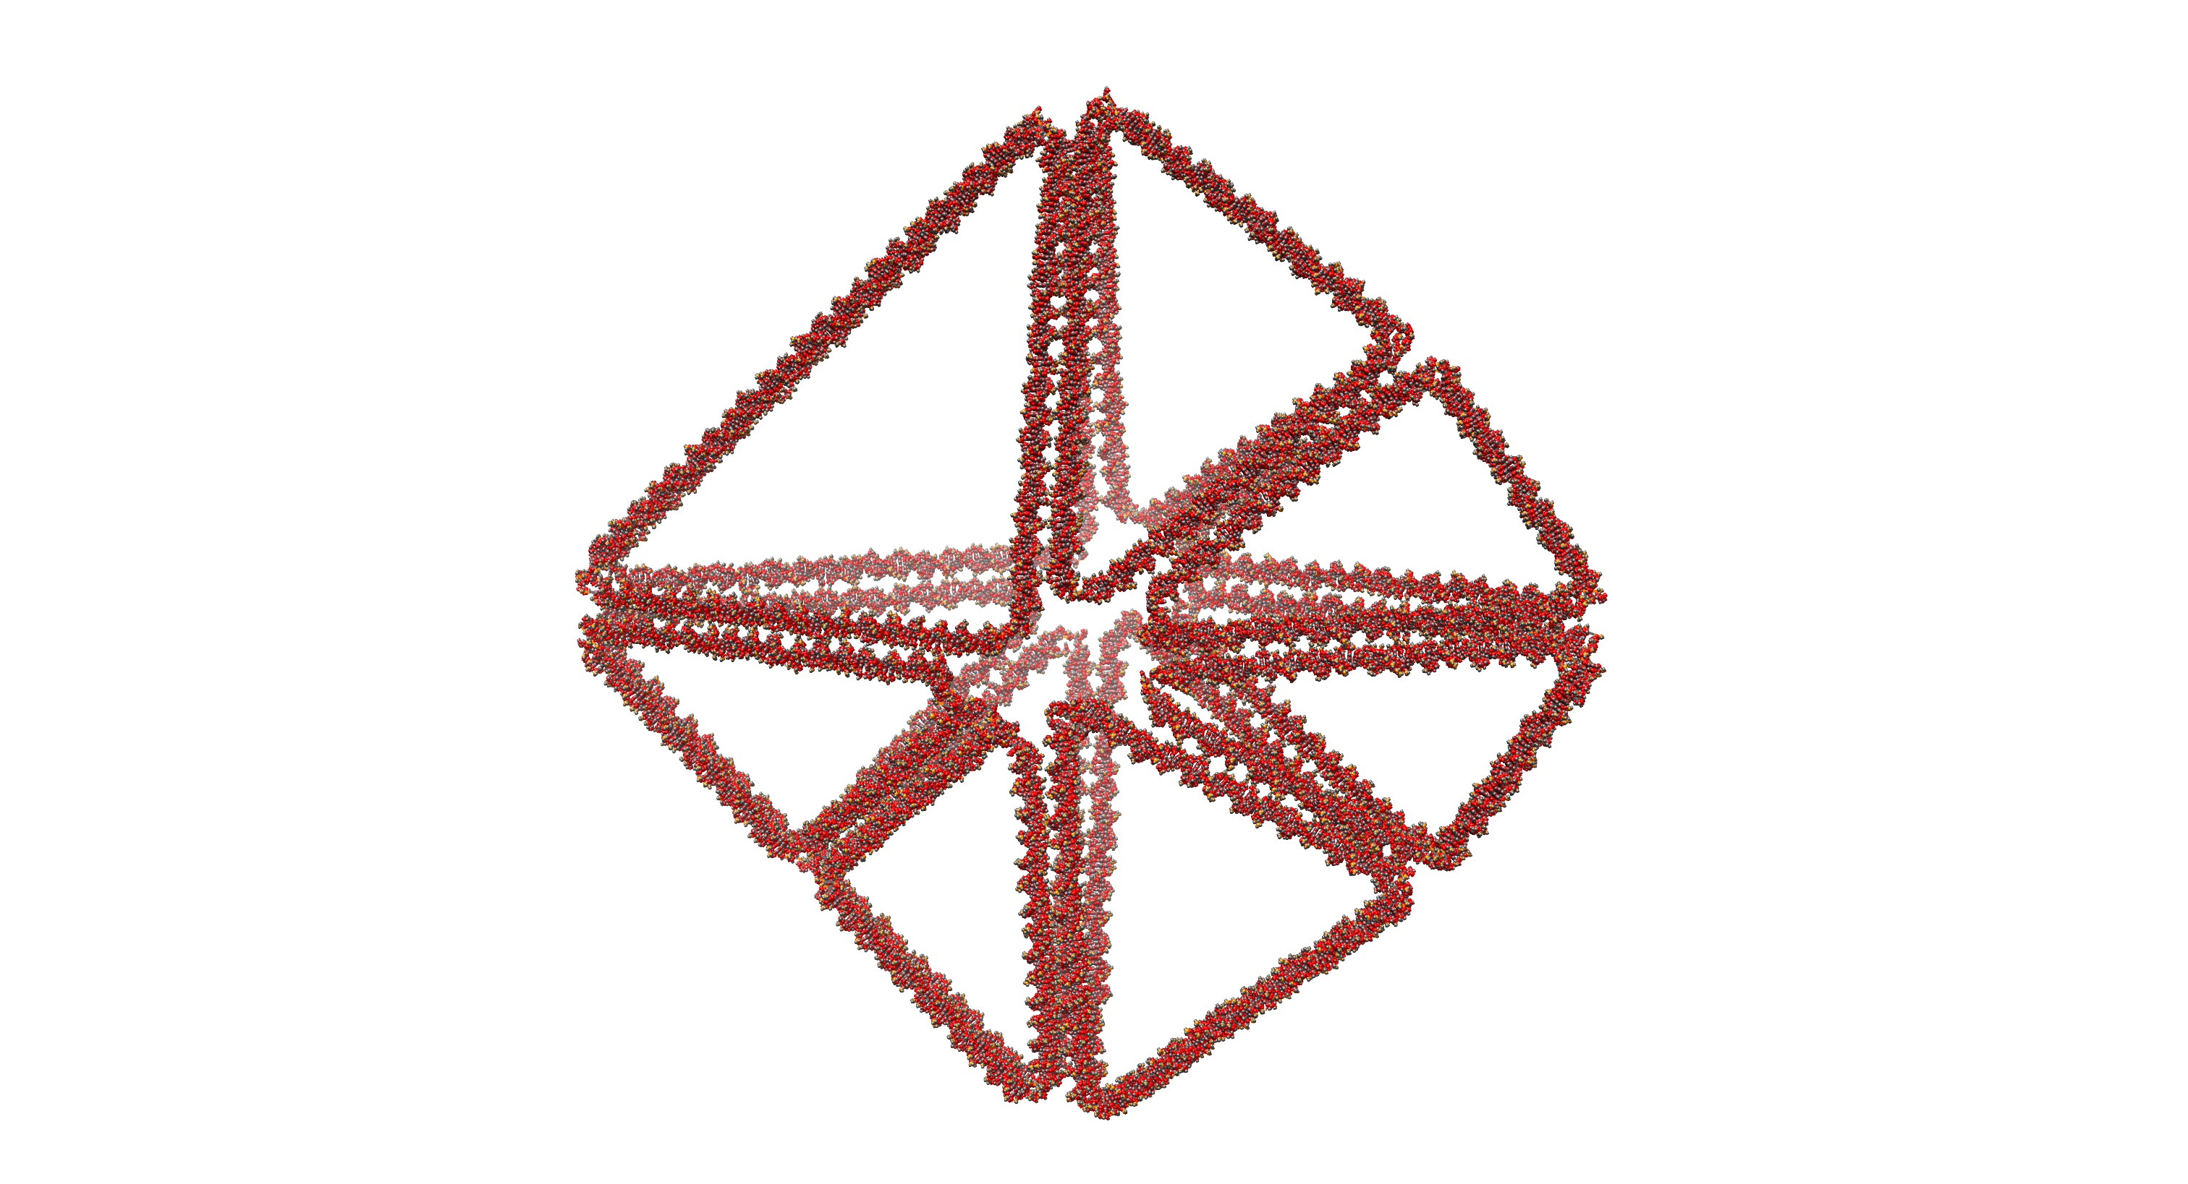
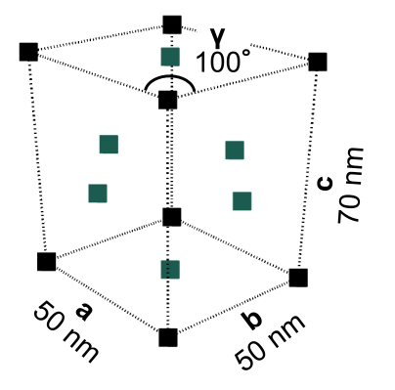
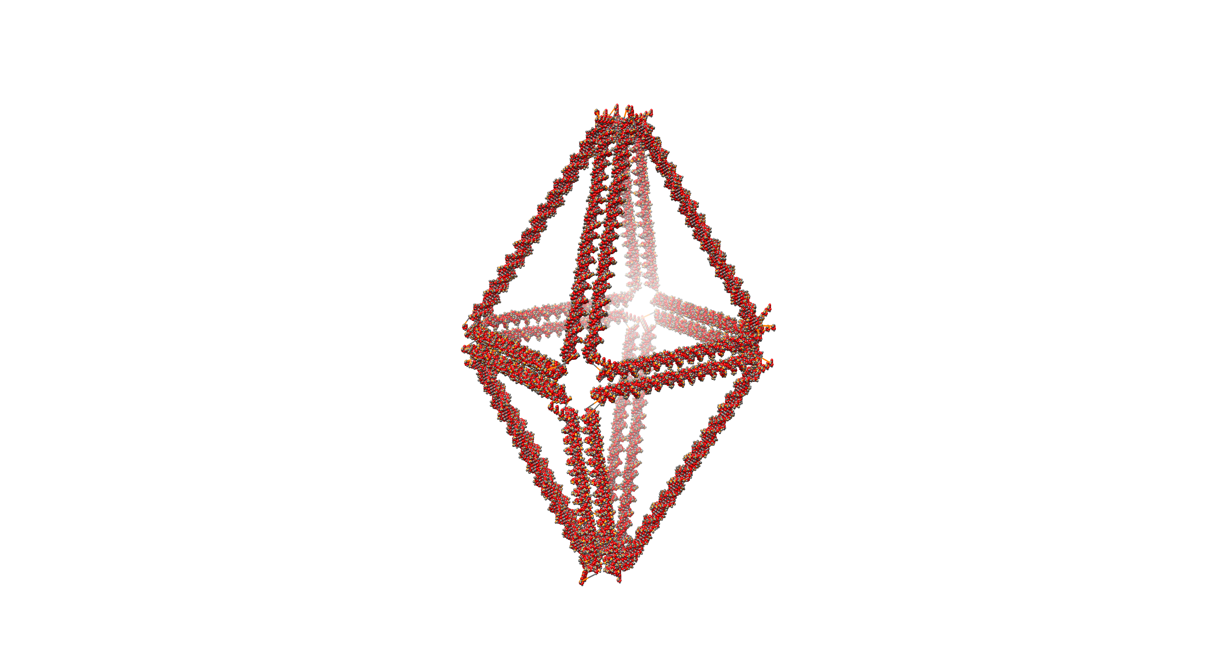
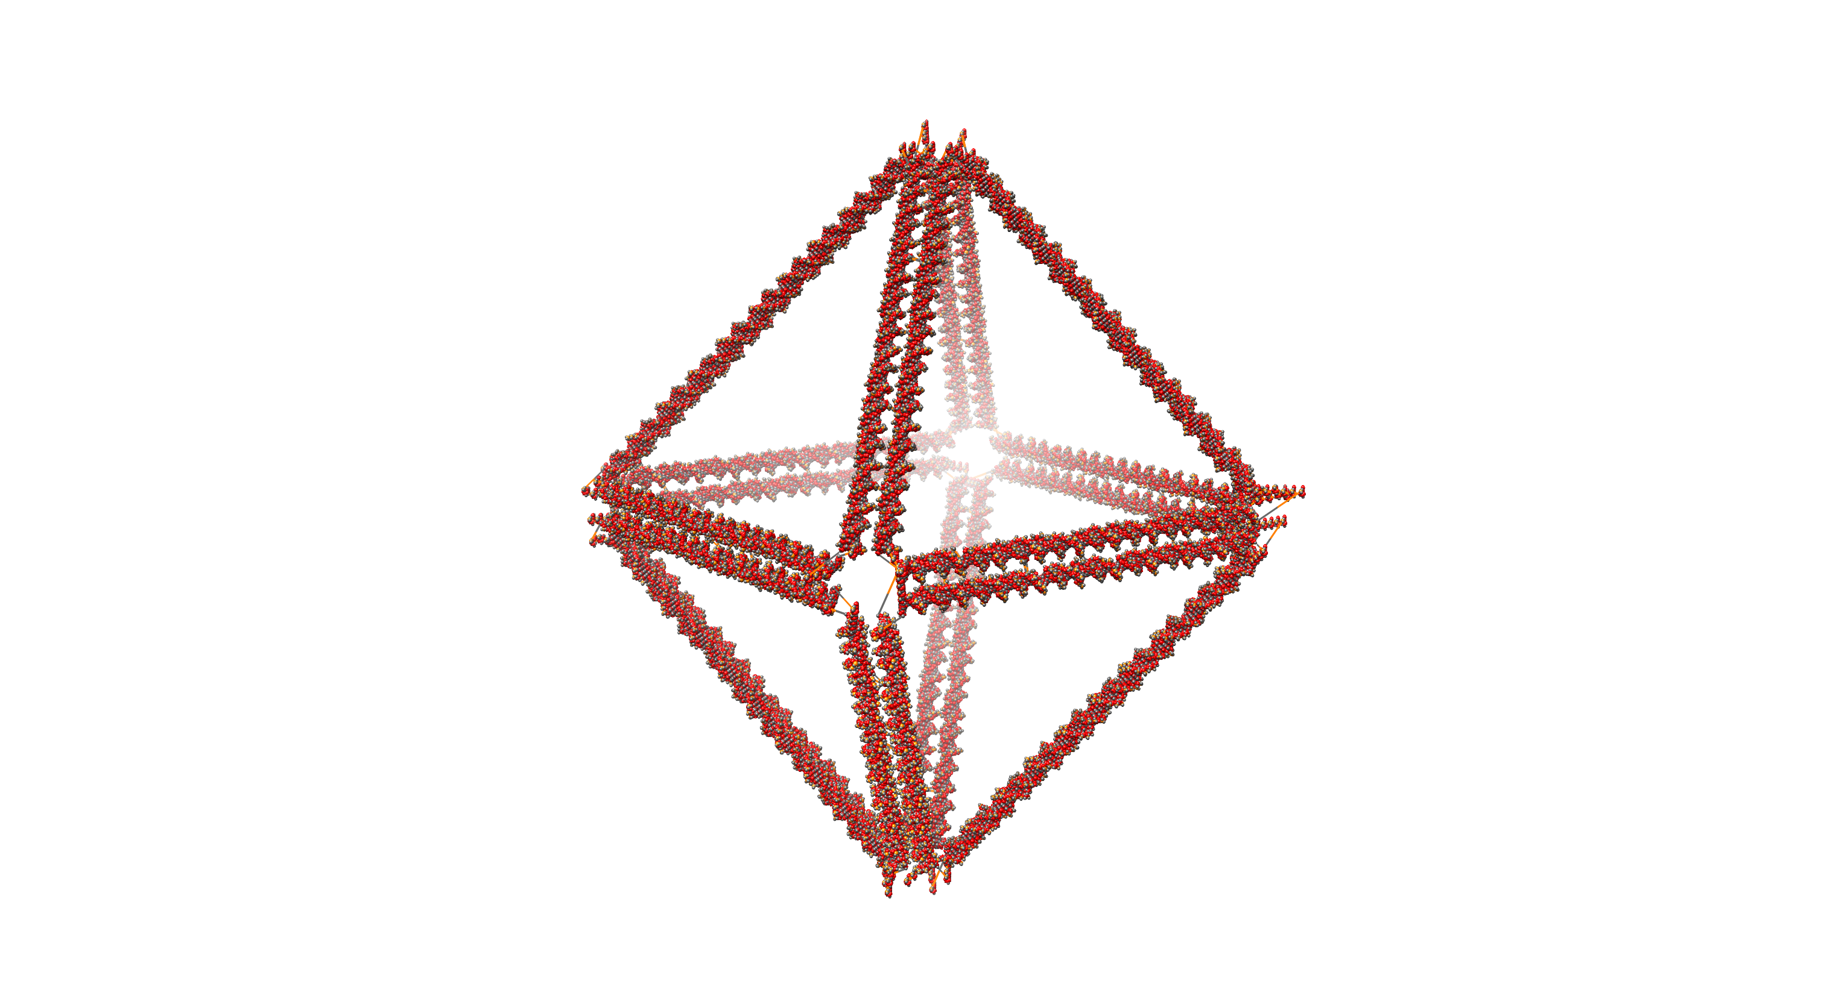
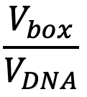

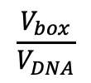
Multiobjective optimization is well-suited for design exploration!
Introduction
Methodology
Results
Conclusions
Q&A
i.
New grammar rules to expand / shorten a, b, c, 𝛾
Values are constrained on range: 25 < a, b, c < 120
ii.
i.
0.2
ii.
Designer
input
0.1
iii.
iii.
iv.
iv.
0
10
20
Custom Objectives
Additional Constraints
$$\frac{V_{box}}{V_{DNA}}$$
d
$$d>d_{min}$$
40 nm
+ Multiobjective shape annealing¹
1. Suppapitnarm et al. Engineering Optimization 33, no. 1 (November 1, 2000): 59–85.

Slide 14
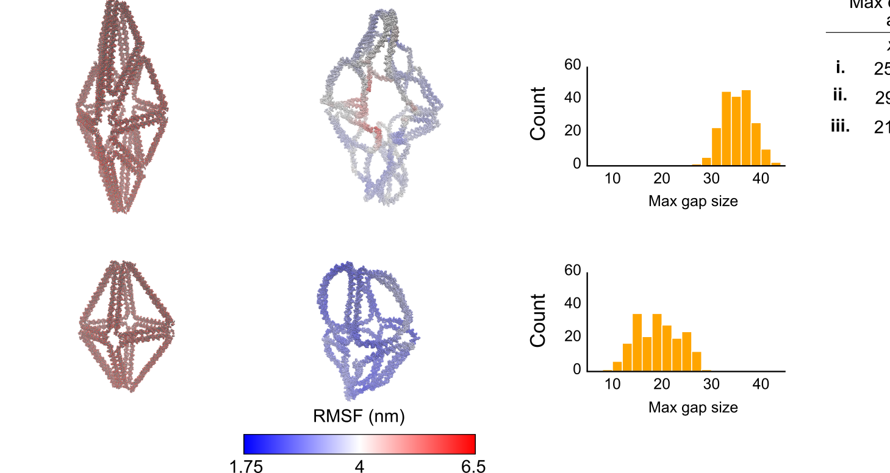
Combined with coarse-grain molecular dynamics¹ simulations, new design features can be studied
Introduction
Methodology
Results
Conclusions
Q&A
Max gap
Size (nm)
With generative design tools often producing non-obvious solutions, it is often the case where simulation results are desired by the designer to validate the solution
Images from https://help.autodesk.com/view/fusion360/ENU/?guid=GD-TUT-GE-BRACKET-QS
1. Coarse grain molecular dynamics simulations performed using oxDNA (Poppleton et al. Journal of Open Source Software 8, no. 81 (2023): 4693.)
GPU acceleration provided by Rovigatti et al. Journal of Computational Chemistry 36, no. 1 (2015): 1–8.

Slide 15
Conclusions
Introduction
Methodology
Results
Conclusions
Q&A
Introduces a design framework capable of generating novel designs within a heavily constrained design space from a minimal set of input conditions
Establishes a design tool which does not require expert-level DNA origami design expertise and allows for design exploration of nanostructures in a side-by-side environment
Does not require a designer to fully conceptualize a solution a priori
No input design required by designer
Outputs many designs that a designer can observe choose from
Vetturini et al. In revision (2024).

Slide 16




Thank you!
Introduction
Methodology
Results
Conclusions
Q&A
Advisors
Professor Jonathan Cagan
Professor Rebecca E. Taylor
My fellow researchers!
Integrated Design Innovation Group
Microsystems and Mechanobiology Lab
This work is supported by the NSF Grant Award CMMI-2113301
See more of my work @ ajvetturini.github.io

Slide 17
Introduction
Methodology
Results
Conclusions
Q&A
Questions?
See more of my work @ ajvetturini.github.io

Slide 18
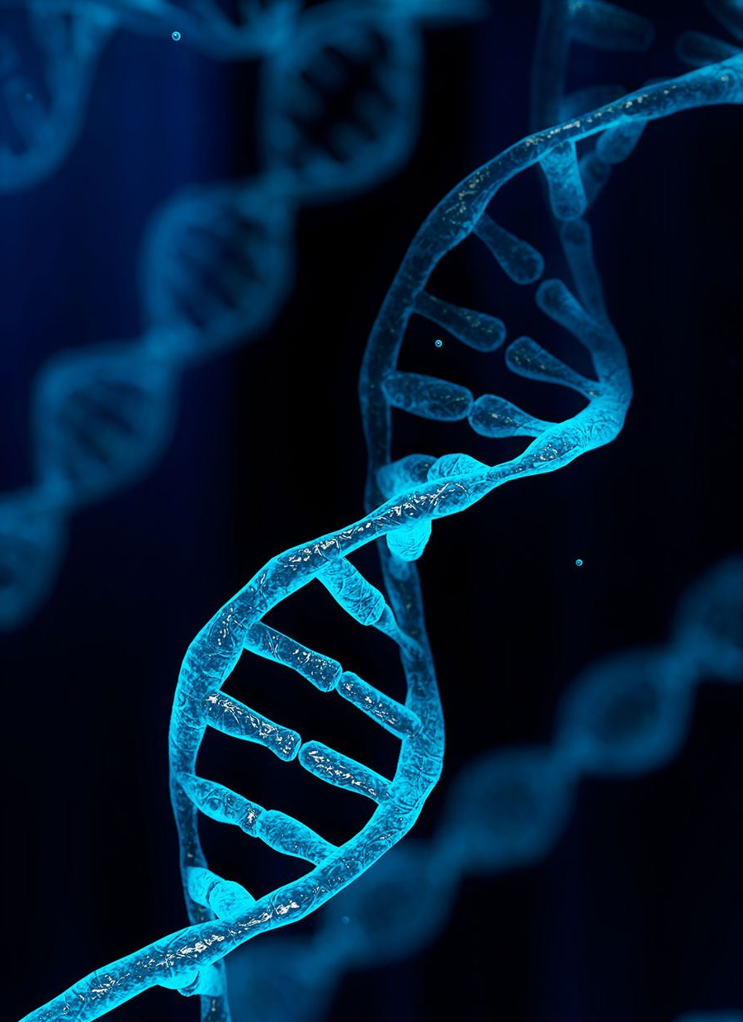
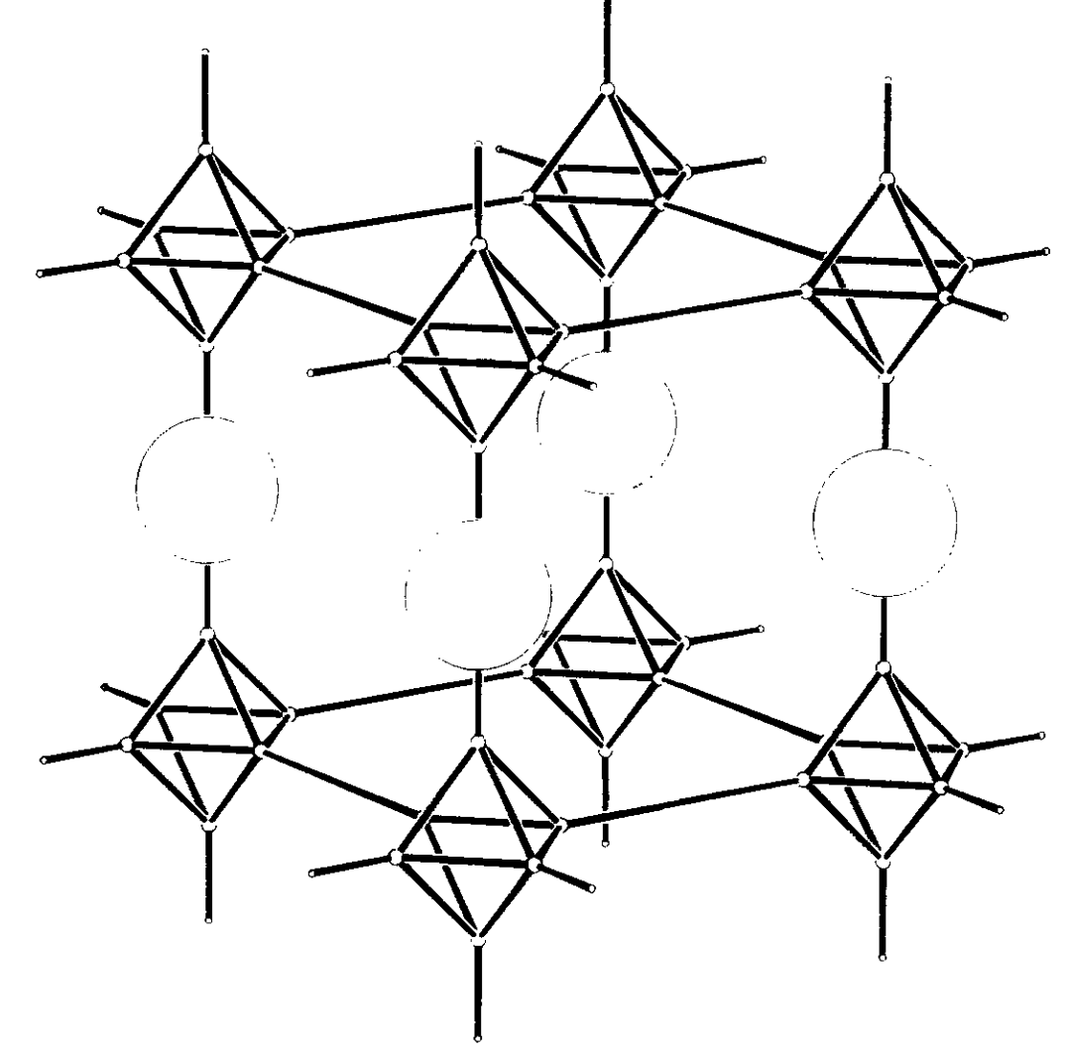
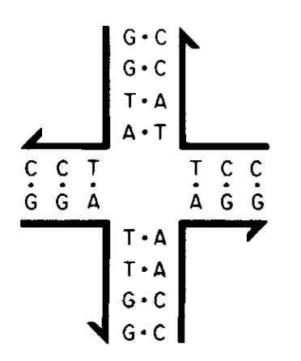
Structural DNA nanotechnology leverages the properties of DNA to create nanostructures
Introduction
Methodology
Results
Conclusions
Q&A
DNA, the polymer
DNA, the structural material
DNA
Junction
Phosphate
backbone
Nucleotides
Nano
particle
https://www.britannica.com/science/DNA
Watson-Crick-Franklin base pairs
Nucleic acid junctions¹ allow for the design of nanometer-scale nanostructures
x
Cytosine
Adenine
Guanine
Thymine
1. Seeman, N. (1986). “Nucleic Acid Junctions and Lattices.” Journal of Theoretical Biology, 99 (2) 237-247.
Notes:
Before I can discuss design automation, I want to quickly discuss how DNA is used as a structural building material

Slide 19
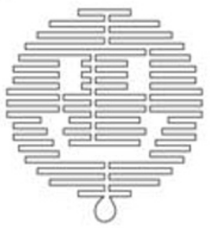

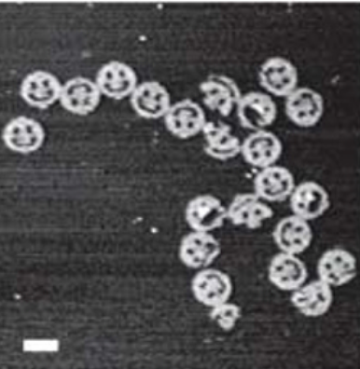

DNA origami is a manufacturing methodology enabling high experimental yield
Introduction
Methodology
Results
Conclusions
Q&A
1.
…
…
…
…
2.
100 nm
https://www.britannica.com/science/DNA
DNA Origami consists of:
Scaffold (~7k nucleotides)
Short, synthetic staples (20-60 nucleotides)
And when combined with a thermal annealing process, DNA origami nanostructures can be formed!
2D DNA origami nanostructures¹
1. Rothemund, “Folding DNA to Create Nanoscale Shapes and Patterns.”

Slide 20
Shape annealing algorithm¹
Random walk of N steps
Reset initial state s_{n=1} and initialize T
Randomly apply rule to s_{n} to create s_{n+1}
Design constraints met?
Yes
Accept s_{n+1}?
No
Iterate success count
Yes
No
No
Limit reached?
Replace active state s_{n} with s_{n+1}
Do probability test
Iterate epoch count
Passed
Iterate accept loop count
Anneal T via annealing schedule
No
Yes
Equilibrium?
Failed
Yes
End!
1. Cagan and Mitchell. Environment and Planning B: Planning and Design 20, no. 1 (1993): 5–12.

Slide 21
Multiobjective shape annealing algorithm¹
Random walk of N steps with archiving
Return to base for state s_{n=1} and initialize all T_{k}
Randomly apply rule to s_{n} to create s_{n+1}
Design constraints met?
Iterate inner loop count
Yes
Archive s₂?
No
Yes
No
No
Iterate inner loop count
Yes
Reassign s_{n} and reset return-to-base count
Yes
Replace active state s_{n} with s_{n+1}
Do probability test
End!
End Search?
Return to base?
Passed
Iterate epoch loop count
Iterate accept loop count
Anneal all T_{k} and reset related counters
Yes
No
Iterate return-to-base count
Anneal T_{k}’s?
Failed
Iterate return-to-base count
1. Suppapitnarm et al. Engineering Optimization 33, no. 1 (November 1, 2000): 59–85.

Slide 22


Automated design software enables rapid sequencing of polyhedral nanostructures
Introduction
Methodology
Results
Conclusions
Q&A
Wireframe DNA origami
Greater specificity in 3D space due to design automation
Often seen as material-efficient
Lattice based designs have larger cross sections⁴
Design automation pipeline
a. Input
b. Select automated software
c. Software produces required sequences
d. Manufacture and characterize
Scaffold
Staple 1
Staple N
ATTCG...
CGTAC…
GCTTA…
Automated
Software^{1,2,3}
DNA origami
…
…
AFM¹
Cryo-EM¹
Standard 3D mesh
Scale bar: 20 nm
1: Veneziano et al., “Designer Nanoscale DNA Assemblies Programmed from the Top Down.”
2: Benson et al., “DNA Rendering of Polyhedral Meshes at the Nanoscale.”
3: Jun et al., “Rapid Prototyping of Arbitrary 2D and 3D Wireframe DNA Origami.”
4: Castro et al., “A Primer to Scaffolded DNA Origami.”
Notes:
REMINDER: You have a scaffold length constraint (a maximum amount of building material)

Slide 23



The HRSV¹ cooling schedule uses the epoch-to-epoch objective function valuations to determine the change in temperature
T_{e}: Temperature at epoch e
$σ_{F_{e}}$: Standard deviation of objective function values at epoch e
1. Huang et al. In Proc. IEEE Int. Conf. on CAD (ICCAD 86), 1986.

Slide 24

The various design constraints of this design space

Slide 25







Lattice-based compared to wireframe DNA origami
Lattice Based
Wireframe
How DNA Origami is manufactured¹
Generated via ATHENA³
Visualized in oxView⁴
Sample 2D DNA Origami²
Higher structural rigidity
More material expensive
Ease of designing in 3D
Less material expensive
Structural rigidity varies
Scaffold
Staples
Image created with BioRender.com.
1. Dey et al., “DNA Origami.”
2. Rothemund, P.W.K. Folding DNA to Create Nanoscale Shapes and Patterns. Nature 2006, 440, 297–302
3. Jun et al., “Rapid Prototyping of Arbitrary 2D and 3D Wireframe DNA Origami.”
4. Poppleton et al., “Design, Optimization and Analysis of Large DNA and RNA Nanostructures through Interactive Visualization, Editing and Molecular Simulation.”
Notes:
1:45
"DNA Origami is a class of DNA Nanostructures where a long scaffold strand is folded into an arbitrary shape through the use of staple strands"
Finite length of scaffold which has defined how we design the structures which lead to these two classes
Mention that the automated routing doesn’t check for strand length so that is based on the designer
Mention what DAEDALUS is for routing DNA in this model
Strength to weight ratio

Slide 26

However, exploring upon the design space for wireframe topologies is difficult
Introduction
Methodology
Results
Conclusions
Q&A
While the design automation greatly reduces the design difficulty, there are still difficulties related to the automated design software motifs
as well the scaffold
length constraint
Difficult to track!
1
1
42
42
1
1
48
48
$$\sqrt{\frac{3}{4}}$$
42
Scale design
Scale design
1
42
1
48
DNA Origami consists of:
Scaffold (~7k nucleotides)
Short, synthetic staples (20-60 nucleotides)
And when combined with a thermal annealing process, DNA origami nanostructures can be formed!
This value can not be exceeded

